Slide 1

Student Management System(mini version)
Ehsan ullah(46465)
Usman Pervez(47419)

Slide 2
Student Management System
A Student Management System (SMS) is a software application or system designed to efficiently manage and organize information related to students within an educational institution. This system is commonly used by schools, colleges, universities, and other educational entities.
Note : The project is completely Console Based.

Slide 3
Planning
➢ We decided to develop a mini version of SMS.
➢ We have gathered information from internet about our project.
➢ We have divided the project into portions.
➢ We used Waterfall Model for our project.
➢ Our project will perform basic functionalities.

Slide 4
Requirements
Login
Data Insertion
Data Display
Data Search via(student id, name, class, course, admission year)
Data Update
Data Deletion
Fee Management
Logout(Exit)

Slide 5
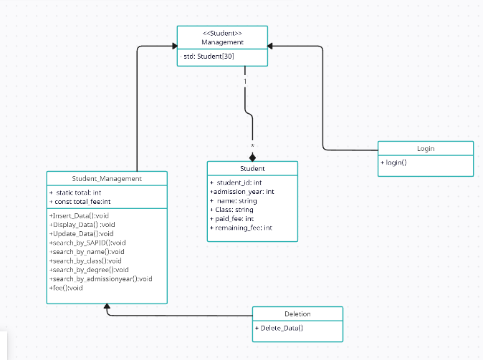
Class Diagram

Slide 6
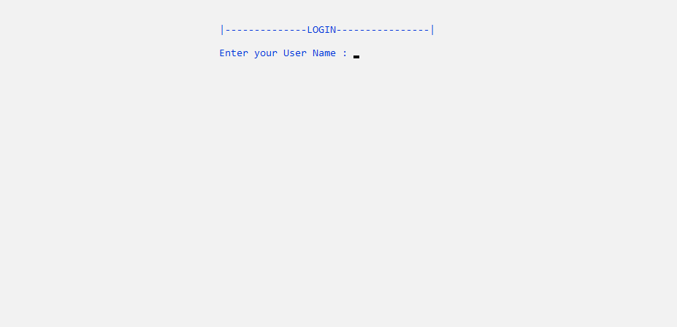
Architectural Design

Slide 7
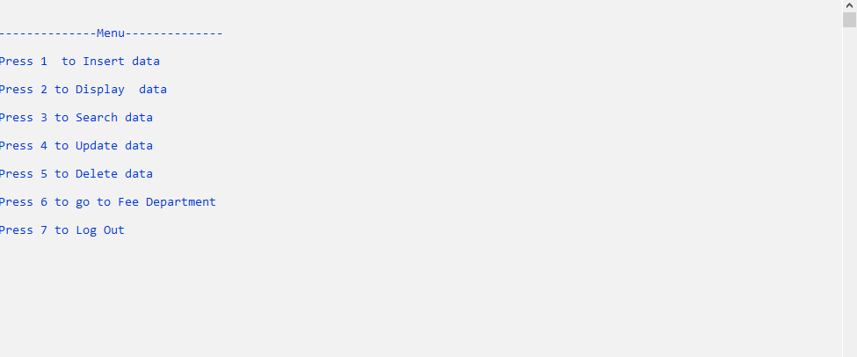
Architectural Design

Slide 8
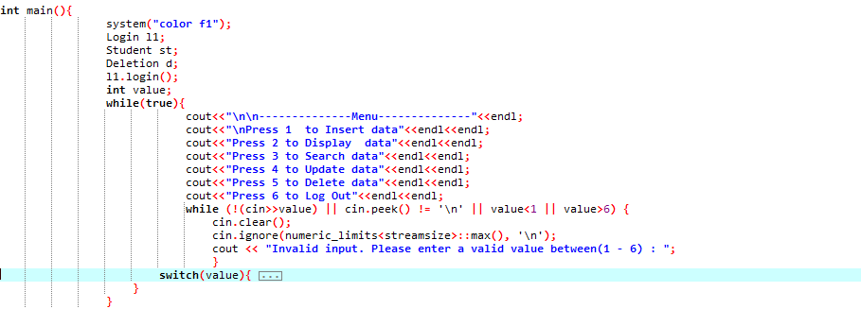
Implementation
• The Project is completely written in c++.
• Project file is uploaded on Moellim.

Slide 9
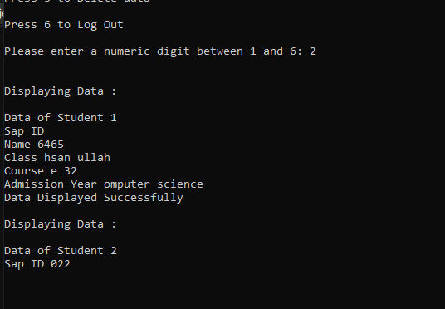
Testing
System will prompt user and will avoid unexpected crashes.
The biggest challenge was the use of getline().It was unable to display the correct data entered. As you can see

